Slide 1
MINI PROJECT
TEAM-15
SHAISHTHA
G SAI AVINASH
A NAGAKUSHAL
NISHEN G
GUIDE:
DR VIAANY

Slide 2
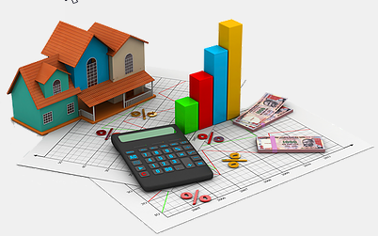
PROJECT TITLE
BENGALURU HOUSE PRICE PREDICTION

Slide 3
APPLICATION/PROBLEM STATEMENT
BENGALURU HOUSE PRICE PREDICTION IS A PREDICTION MODEL THAT IS BUILT TO GIVE THE END USER , THE OVERVIEW OF THE HOUSE PRICES IN THE DESIRED AREA OF BENGALURU.
WITH THIS MODEL ,BUYER WILL BE ABLE TO GRASP THE ROUGH ESTIMATES OF THE PRICES CURRENTLY TRENDING THE MARKET.
SINCE THE MODEL IS DEPLOYED ON THE WEB , IT IS AVAILABLE FOR EVERYONE OUT THERE.

Slide 4
POSSIBLE APPROACHES
MACHINE LEARNING MODELS LIKE LINEAR REGRESION TO PREDICT THE TARGET VALUES .
USING TIME-SERIES FORECASTING TECHNIQUES.
USING ADVANCED MACHINE LEARNING TECHNIQUES LIKE BAGGING / BOOSTING TECHNIQUES.
USING DEEP LEARNING MODELS LIKE ARTIFICIAL NEURAL NETWORK (ANN’S) TO PREDICT THE TARGET VALUES

Slide 5
PREVIOUS WORKS :
RESEARCHERS HAVE USED METHODS LIKE LINEAR REGRESSION .
House Price Prediction Using Machine Learning : ANAND G. RAWOOL1 , DATTATRAY V. ROGYE2 , SAINATH G. RANE3 , DR. VINAYK A. BHARADI4.
METHODS LIKE Stacked Generalization , Hybrid Regression , Light Gradient Boosting Machine (LightGBM) have also been tried.
Housing Price Prediction via Improved Machine Learning Techniques
Quang Truong, Minh Nguyen, Hy Dang, Bo Mei

Slide 6
OBJECTIVE :
THE MAIN OBJECTIVE HERE IS TO IMPLEMENT THE DEEP LEARNING METHOD CALLED ARTIFICAL NEURAL NETWORK TO SOLVE THE PROBLEM STATEMENT.
THERE ARE MANY APPROACHES ALREADY USED TO SOLVE THIS PROBLEM AND ARE PUBLISHED IN THE RESERARCH PAPAERS.
HERE , WE ARE TRYING TO IMPLEMENT ANN’S AND SEE IF WE CAN ATTAIN BETTER ACCURACY IN SOLVING THE PROBLEM.

Slide 7
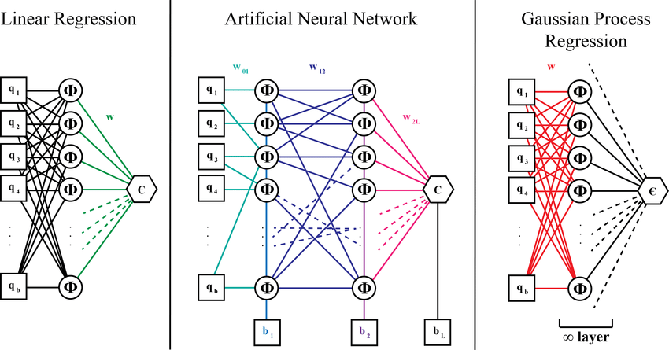
APPROACH TO THE PROBLEM
USING DEEP LEARNING TECHNIQUE
IMPLEMENTING ARTIFICIAL NEURAL NETWORKS
TWEAKING HYPERPARAMETERS LIKE HIDDEN LAYERS , OPTIMIZERS , LOSS FUNCTION , ACTIVATION FUNCTION TO ATTAIN FAIR ACCURACY.

Slide 8
DEEP LEARNING
Deep learning is a machine learning technique that teaches computers to do what comes naturally to humans
Deep learning is a key technology behind driverless cars, enabling them to recognize a stop sign, or to distinguish a pedestrian from a lamppost.
Deep learning is an important element of data science, which includes statistics and predictive modeling.
It is extremely beneficial to data scientists who are tasked with collecting, analyzing and interpreting large amounts of data; deep learning makes this process faster and easier.

Slide 9
ARTIFICIAL NEURAL NETWORK
The term "Artificial neural network" refers to a biologically inspired sub-field of artificial intelligence modeled after the brain.
An Artificial neural network is usually a computational network based on biological neural networks that construct the structure of the human brain
Similar to the human brain that has neurons interconnected to one another, artificial neural networks also have neurons that are interconnected to one another in various layers of the networks. These neurons are known as nodes.

Slide 10
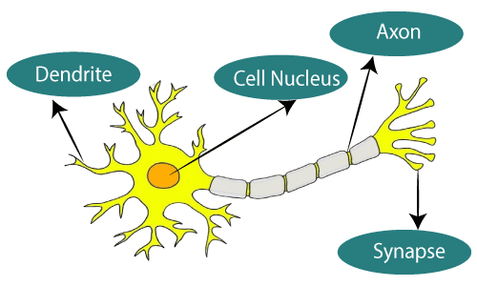
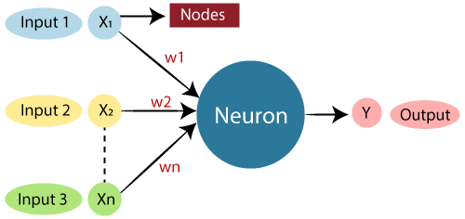
COMPARISION
Biological Neural Network
Artificial Neural Network

Slide 11
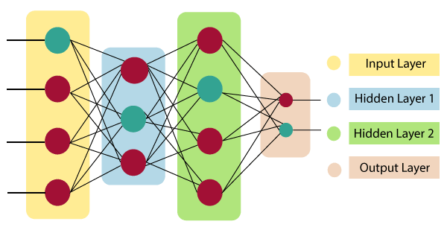
ARCHITECTURE OF ANN

Slide 12
ARCHITECTURE OF ANN
Input Layer:
As the name suggests, it accepts inputs in several different formats provided by the programmer.
Hidden Layer:
The hidden layer presents in-between input and output layers. It performs all the calculations to find hidden features and patterns.
Output Layer:
The input goes through a series of transformations using the hidden layer, which finally results in output that is conveyed using this layer.The artificial neural network takes input and computes the weighted sum of the inputs and includes a bias. This computation is represented in the form of a transfer function.

Slide 13
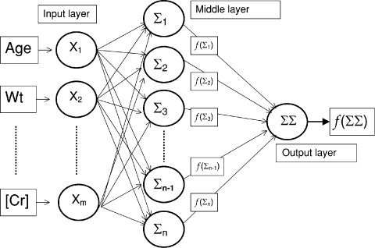
WORKING OF MODEL ON OUR DATASET:
AREA
NO OF ROOMS
PRICE
NO OF BALCONY

Slide 14
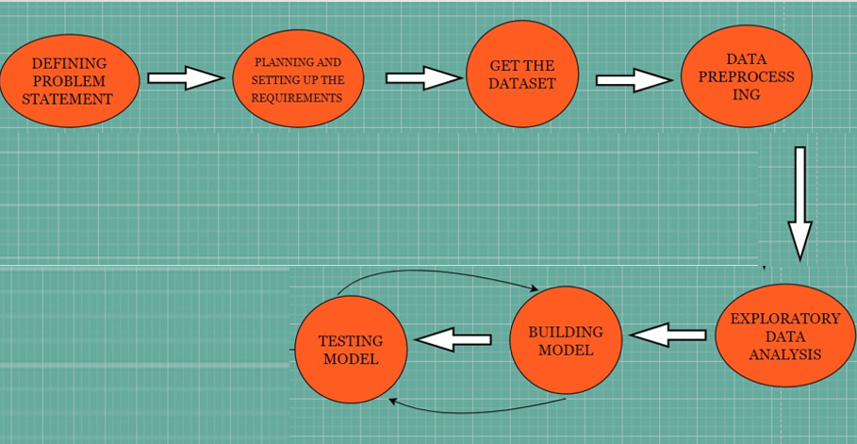
WORKFLOW:

Slide 15
STAGES OF THE PROJECT
DEFINING PROBLEM STATEMENT
PLANNING AND SETTING UP THE REQUIREMENTS
GET THE DATASET
DATA-PREPROCESSING
BUILDING MODEL
TESTING MODEL
DEPLOYMENT

Slide 16
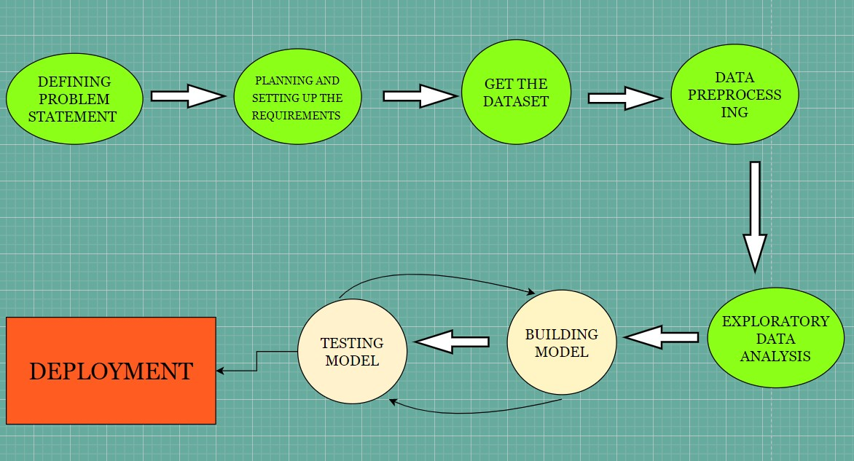
PROGRESS
WE HAVE FINISHED INITIAL STAGES WITH OUTMOST EFFORT AND NOW AT THE MODEL BUIDING STAGE.

Slide 17
Review 1 Feedback
Since the sir asked us to compare several models instead of doing one, we have included following models;
SVM
Random Forest
Lasso Regression
Ridge Regression
Linear Regression

Slide 18
SVM Model
Supervised Machine Learning Algorithm
Classification and Regression
Used to compute objective function
Select optimal subset of features

Slide 19
Random Forest
Better than most of the existing models
Adds additional randomness to the model
Used in both classification and Regression
Based on the concept of ensemble learning
Prevents overfitting

Slide 20
Linear Regression
Statical method used for predictive analysis
Used for continuous, real or numerical variables
Shows the relationship between dependent and one or more dependent variables

Slide 21
Lasso Regression
L1 Regularization technique
Stands for Least Absolute and Selection Model
Shrinks the slope to 0

Slide 22
Ridge Regression
L2 Regularization technique
Lambda value tends to 0
Used for solving problems which have more parameters than samples
Small amount bias is introduced in long term prediction

Slide 24
REFERENCES :
House Price Prediction Using Machine Learning : ANAND G. RAWOOL1 , DATTATRAY V. ROGYE2 , SAINATH G. RANE3 , DR. VINAYK A. BHARADI4. (BASE PAPER)
Quang Truong, Minh Nguyen, Hy Dang, Bo Mei .Housing Price Prediction via Improved Machine Learning Techniques
Fan C, Cui Z, Zhong X. House Prices Prediction with Machine Learning Algorithms. Proceedings of the 2018 10th International Conference on Machine Learning and Computing ICMLC 2018. doi:10.1145/3195106.3195133.

Slide 25
THANK YOU

